Slide 1
High fidelity simulations of Taylor bubbles in turbulent co-current flow
Delft University of Technology
Traianos Karageorgiou
February 21, 2020

Slide 2
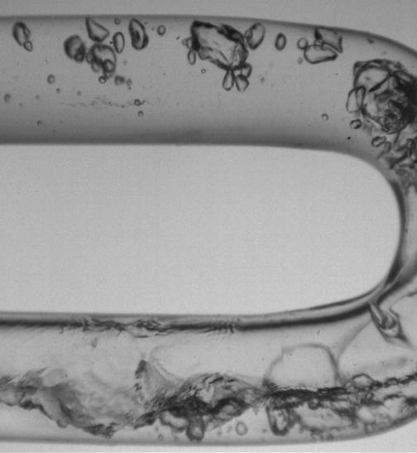
Table of contents
Multiphase flows
Taylor bubble flow
Modeling methods of Taylor bubbles
Previous Research
Future work
Research Questions

Slide 3
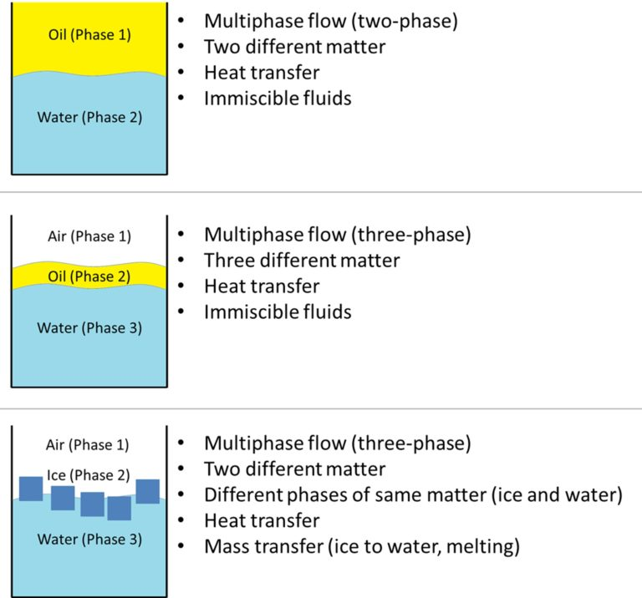
Mutliphase flows - Definition
Simultaneous flow of material in two or more different thermodynamic states or phases
or
simultaneous flow of two or more materials with different physical properties but in the same phase or state.

Slide 4
Multiphase flow – Numerical modeling
Main steps for the modeling of a multiphase flow:
the specification of the physical process and properties,
the identification of the multiphase flow regime, and
the determination of the mathematical model.
Three main flow regimes for immiscible fluids (gas-liquid):
Dispersed flow.
Flow with separated phases.
Mixed / Intermittent Phases.

Slide 5
Multiphase flow - Flow regimes
Important variables:
orientation and radius of pipe,
fluids' properties (ρ, μ, σ)
volumetric flow rate of
each phase.
Large difference between fluids' bulk velocities leads to Kelvin- Helmholtz instabilities of interface.

Slide 6
Multiphase flow - Natural process
Several phenomena may occur:
Hydrodynamic effects which change the interface e.g. particle-wall / particle particle collision, coalescence, turbulent flow etc.
Transport phenomena:
e.g. heat transfer, mass transfer, change in
composition or/ and heterogeneous reactions.

Slide 7
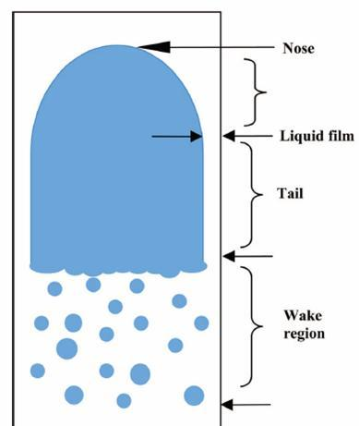
Taylor bubble flow - Definition
A large and bullet-shaped bubble, rising through liquid in a vertical pipe.
Occupies almost the entire cross section of the pipe and is formed by coalescence of small bubbles.
Usually followed by other Taylor bubbles, which are separated from each other by liquid slugs (slug flow).

Slide 8
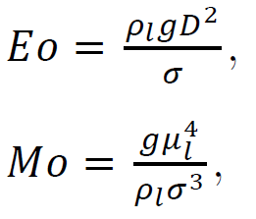
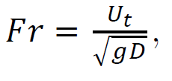
Taylor bubble flow - Dynamics
Taylor bubble is rising due to boyancy until a terminal velocity and shape (not always).
Unsteady and aperiodic behavior.
Important dimensionless numbers for the dynamics of the bubbles:
output
input

Slide 9
Taylor bubble flow - Applications
Applications of Taylor bubbles in industry:
geothermal power plants,
evaporation and condensation in thermal power plants,
oil extraction from wells,
transportation of hydrocarbons through pipes,
in the emergency core cooling of nuclear reactors.

Slide 10
Modeling methods – Governing equations
Navier Stokes equations for each phase
Inertia = pressure + viscous + external forces
Conservation of mass for each phase. Incompressible flow:
The liquid and the Taylor bubble are seperated by non-stationary, immiscible, sharp interface.
Numerical modeling method for capturing gas-liquid interface.

Slide 11
Modeling methods – Interface
Incompressible, immiscible fluids, sharp representation of undsteady interface.
Target: knowledge of interface’s location and curvature.
Eulerian front-capturing (implicit construction of interface) and front-tracking methods (explicit construction of interface).

Slide 12
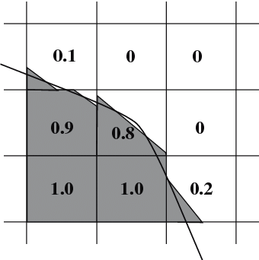
Modeling methods – VoF (1/2)
Volume of fluid (VoF) method:
+ : volume conservative,
- : computationally expensive, cannot provide inteface location in the cell.
After mesh generation, compute gas volume fraction 𝛼
α=1 ,only gas in this cell
α=0 ,only liquid in this cell
0<α<1 ,interface passes
through this cell

Slide 13
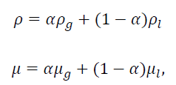
Modeling methods – VoF (2/2)
When 0<α<1 interface passes through this cell, then density and viscosity are computed by linear interpolation:
Transport equation defines how the scalar quantity α is transported in space with mixture velocity u
The mixture velocity u applies to the governing equations with an additional capillary term

Slide 14
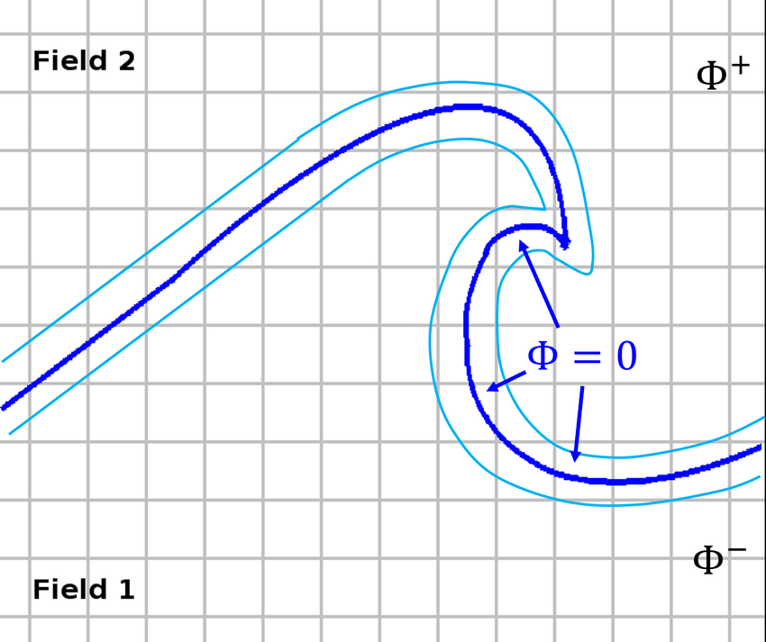
Modeling methods - Level Set (1/2)
Level - Set (LS) method defines an Eulerian distance function φ (named level-set function) which is transported and is set at zero level at the interface.
+ : Simple, straightforward interface representation, computationally efficient even for complex topologies
- : incapable of conserving the liquid and gas volume over time, need for re-initialization after some time steps

Slide 15
Modeling methods - Level Set (2/2)
The LS function 𝜙 is a signed scalar quantity can be applied to the transport equation:
LS function is an Eulerian function so
LS incapable of conserving the liquid and gas volume.
Need to define a Heaviside kernel function 𝐻(𝜙) to avoid instabilities:
Material properties such as density and viscosity are defined now:
Governing equations are the same as in VoF method.

Slide 16
Modeling Methods – Dual/Coupled (1/2)
Combine LS and VoF methods by benefiting from their advantages (straightforward interface representation and volume conservative) and minimizing their disadvantages.
Great variety of dual interface methods found in the literature :
CLSVOF, MCLS, ACLSVOF, VOSET etc.

Slide 17
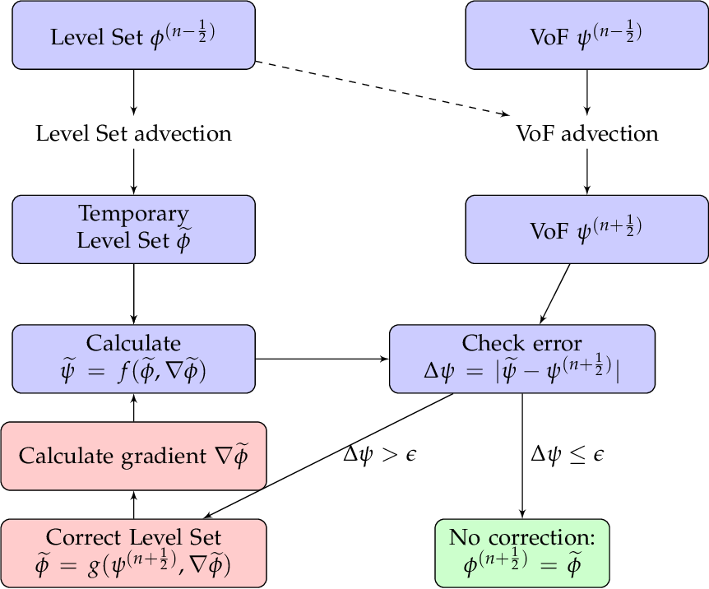
Modeling Methods – MCLS method (2/2)
Mass-Conserving Level Set method (MCLS) has good levels of robustness and accuracy.
MCLS algorithm in cylindrical coordinates eliminates instabilities and singularities and is computationally cheap.

Slide 18
Previous research

Slide 19
Scientific gap
Lack of realistic and accurate data.
Simulations in 2D, stagnant liquid steady behavior of Taylor bubbles.
3D simulation necessary for Taylor bubble with large inverse viscosity number.
Scientific gap = a fully three-dimensional simulation of a Taylor bubble in a turbulent co-current liquid flow.

Slide 20
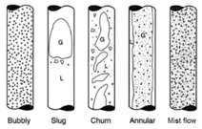
Future work
Focus on the slug flow regime. Steps:
Learning Basilisk, an open-source flow solver that employs the VoF approach and allows local refinement in the areas of interest.
Development of some simple test cases.
Validation of the Basilisk solver in single-phase turbulent pipe flow.
Laminar Taylor bubble flow rising in stagnant liquid based on Araujo [1].
High fidelity simulations of Taylor bubbles in
co-current turbulent flow, and comparison
against either experiments from literature or
NRG simulation results from OpenFOAM.
[1] Araújo, J. D. P., et al. International Journal of Multiphase Flow 43 (2012): 131-148.

Slide 21
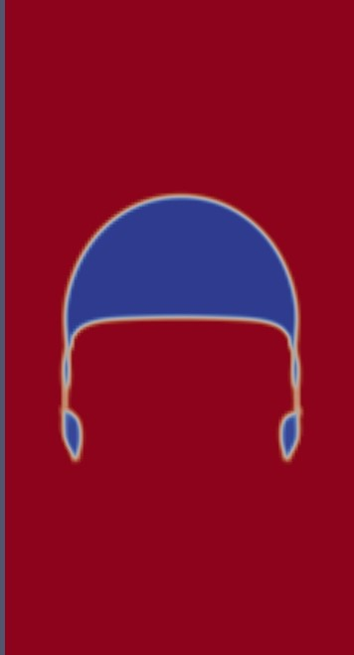
Sub-questions
By default the domain in Basilisk is cube in 3D.
How can the domain of cylindrical pipe be constructed?
How can we simulate a fixed wall?
Due to strong shear stresses, progressive reduction to Taylor'sbubble size. What time-averaging strategy will be used?
Is the breakup of small bubbles physical or not? How can we capture accurately the break up phenomenon?
What can be done to avoid instabilities of the interface?
Due to wall friction, the liquid loses kinetic energy. How can we keep the liquid flow turbulent in the wake region?

Slide 22
Research Question
What simulation strategy can be developed in Basilisk to accurately reproduce the motion of an individual Taylor bubble in turbulent co-current background liquid flow?
Notes:
From oud ''As for the rising bubble case, the main interest lies in the rise velocity of the bubble [2, 50, 86], as well as in the thickness of the falling liquid
film between the bubble and the pipe wall and the wake of the bubble''
1. What’s the difference between octree and multigrid? What are the features of both?
2. What data is contained per MPI process? Does this depend on octree and multigrid?
3. How are MPI processes distributed in space? Can it be controlled? Again: differences between octree and multigrid?
4. Can we control local grid refinement (i.e., near the wall, near a bubble or near small turbulent structures), and is there something like processor load balancing?
5. How can we simulate a fixed wall? Maarten was doing something with damping of the solution…

Slide 23
Thank You!

