Slide 1
Modeling Electromagnetic Fields
An Application in MRI Kirsten Koolstra
April 22nd, 2015

Slide 2
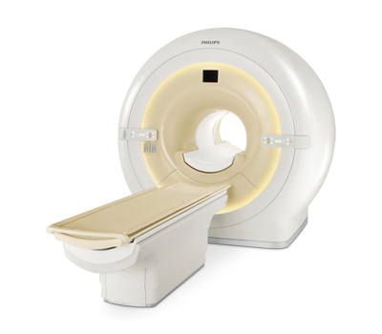
Introduction
Magnetic Resonance Imaging (MRI)

Slide 3
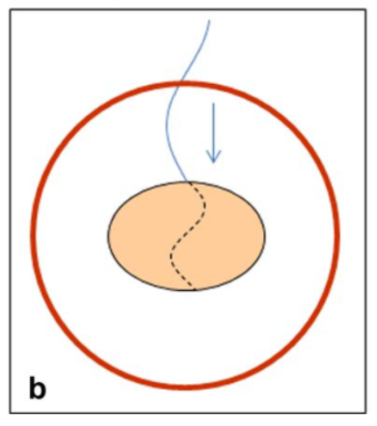
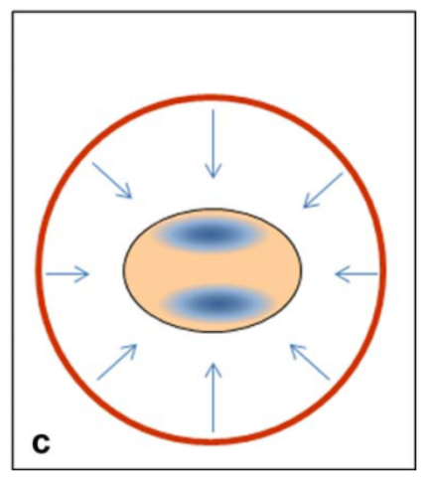
Introduction
RF Interference in MRI
$$λ∝\frac{1}{B_{0}}$$
$$B_{0}=1.5 T$$
$$B_{0}=3.0 T$$

Slide 4
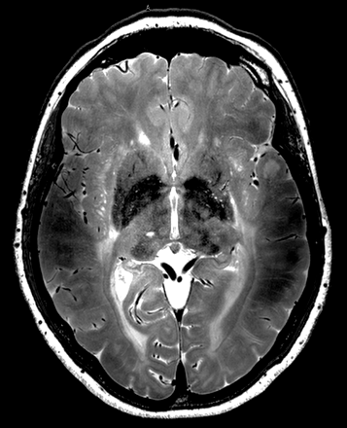
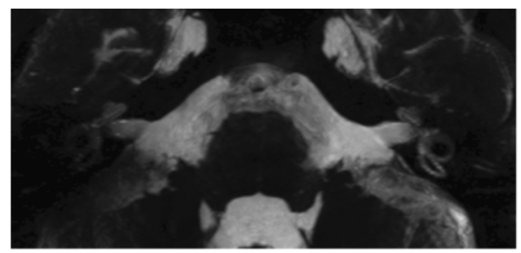

Slide 5
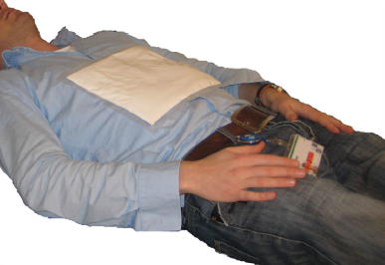
Introduction
The Effect of Dielectric Pads

Slide 6
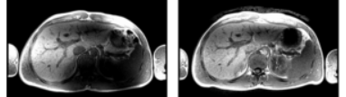
Introduction
The Effect of Dielectric Pads
Without pad
With pad
Without pad
With pad

Slide 7
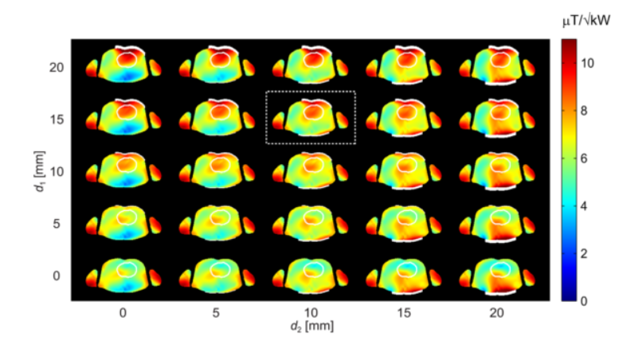
Introduction
Design Procedure: Numerical Modeling

Slide 8
Challenges
Strong (localised) inhomogeneities in medium parameters
Large computational domain due to the body model
Accurate for low resolution!
Fast!
Take into account the boundary conditions

Slide 9
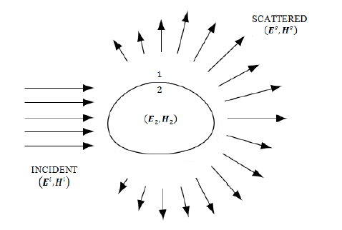
The Volume Integral Equation (VIE)
$$E^{inc}=E−\left(k_{b}^{2}+∇∇∙\right)S\left(χ_{e}E\right)$$
$$S(J)=\int_{Ω}{g\left(x′−x\right)J\left(x\right)dx}$$

Slide 10
Different Formulations
$$D_{c}=ε_{c}E \\ J= η_{0}χ_{e}E$$
$$𝒩=k_{b}^{2}+∇∇∙$$
EVIE: $E^{inc}= E − 𝒩S\left(χ_{e}E\right)$
DVIE: ${ E}^{inc} = \frac{1}{ε_{c}}D_{c} − 𝒩S(\frac{χ_{e}}{ε_{c}}D_{c})$
JVIE:${ { η}_{0}χ_{e}E}^{inc} = J − 𝒩S(J)χ_{e}$

Slide 11
The Method of Moments
$$ℒu=f$$
Derive weak form $\left\langle ℒu,η\right\rangle =\left\langle f,η\right\rangle$.
Define a mesh.
Expand the unknown $u$ through basis functions $φ_{i}.$
Choose test functions $η_{i}$.
Calculate/approximate the integrals.
Define the discretised system
$$\left[\begin{matrix}a_{xx} & a_{xy} \\ a_{yx} & a_{yy}\end{matrix}\right]\left[\begin{matrix}e_{x} \\ e_{y}\end{matrix}\right]=\left[\begin{matrix}b_{x} \\ b_{y}\end{matrix}\right].$$

Slide 12
Test Functions
Callocation Method: ${ η}_{i}\left(x\right) = δ\left(x−x_{i}\right)$
Galerkin’s Method: ${ η}_{i}\left(x\right) ={ φ}_{i}(x)$

Slide 13
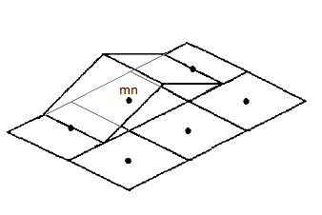
Basis Functions
Rooftop
$$x$$
$$y$$
$$y$$
$$x$$

Slide 14
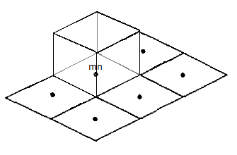
Basis Functions

Slide 15
A Closer Look
EVIE Formulation
EVIE: $E^{inc}= E − 𝒩S\left(χ_{e}E\right)$
DVIE: ${ E}^{inc} = \frac{1}{ε_{c}}D_{c} − 𝒩S(\frac{χ_{e}}{ε_{c}}D_{c})$
JVIE:${ { η}_{0}χ_{e}E}^{inc} = J − 𝒩S(J)χ_{e}$

Slide 16
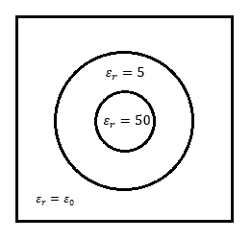
A Closer Look
Scattering on a Two-Layered Cylinder
TE-polarisation
$E^{inc}=−e^{−ik_{b}y}$
$f=128 Hz$
$$x$$
$$y$$

Slide 17
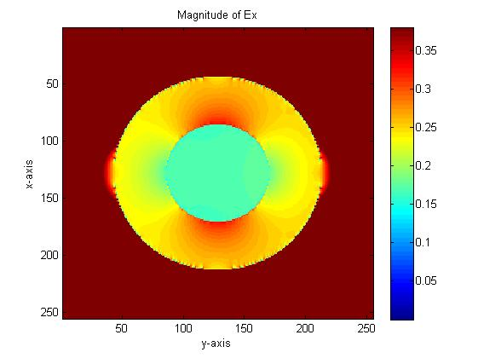
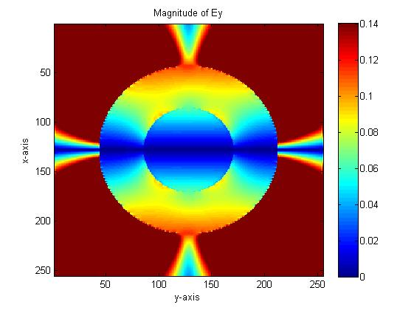
A Closer Look
Scattering on a Two-Layered Cylinder

Slide 18
Some Observations
Contrast: Low contrast vs high contrast
Basis functions: Rooftop vs 2 x linear
Geometry: Cylinder vs square

Slide 19
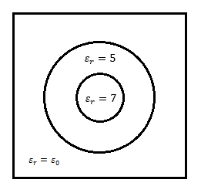
Observation 1
Low Contrast vs High Contrast

Slide 20
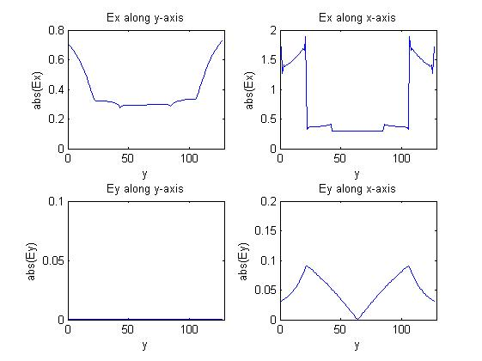
Observation 1
Low Contrast vs High Contrast

Slide 21
Observation 2
Rooftop Expansion vs Linear Expansion

Slide 22
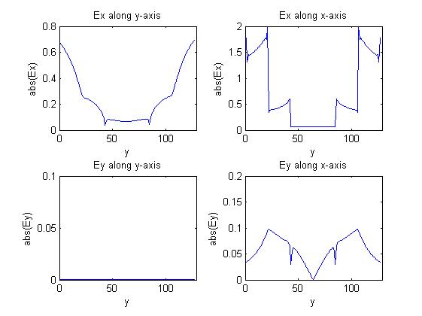
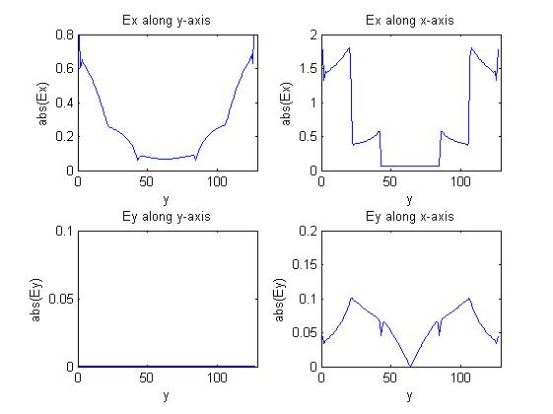
Observation 2
Rooftop Expansion vs Linear Expansion

Slide 23
Observation 3
Two-Layered Cylinder vs Two-Layered Square

Slide 24
Observation 3
Two-Layered Cylinder vs Two-Layered Square

Slide 25
What is the cause of these jumps?
Basis functions?
Formulation?
Geometry?

Slide 26
Approach
Compare the EVIE formulation with the DVIE and JVIE formulations.
Analysing contrast dependency.
Find out what happens for different geometries.
Compare the performance of GMRES and IDR(s) methods.
Accurately
Fast

Slide 27
Function Spaces
EVIE: $H\left(curl,ℝ^{3}\right)⟼ H\left(curl,ℝ^{3}\right)$
DVIE: $H\left(div,ℝ^{3}\right)⟼ H\left(curl,ℝ^{3}\right)$ JVIE: ${\left[L^{2}\left(ℝ^{3}\right)\right]}^{3}⟼{\left[L^{2}\left(ℝ^{3}\right)\right]}^{3}$
where
$$H\left(curl,ℝ^{3}\right)=\left\{f | f∈L^{2}\left(ℝ^{3}\right)∧ ∇×f∈L^{2}\left(ℝ^{3}\right)\right\}$$
$$H\left(div,ℝ^{3}\right)=\left\{f | f∈L^{2}\left(ℝ^{3}\right)∧ ∇∙f∈L^{2}\left(ℝ^{3}\right)\right\}$$

