Slide 1
Modeling Electromagnetic Fields in Strongly Inhomogeneous Media
An Application in MRI
Kirsten Koolstra, September 24th, 2015

Slide 2
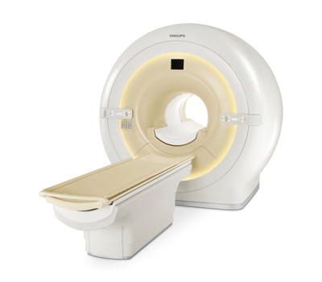
Introduction
Magnetic Resonance Imaging (MRI)
www.neurensics.com/technische-specificaties

Slide 3
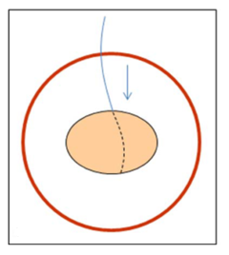
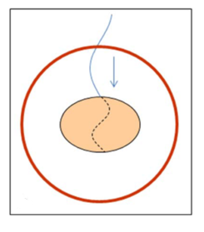
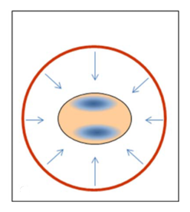
Introduction
RF Interference in MRI
$$λ∝\frac{1}{B_{0}}$$
$$B_{0}=1.5 T$$
$$B_{0}=3.0 T$$
Brink et al., JMRI (2015)

Slide 4
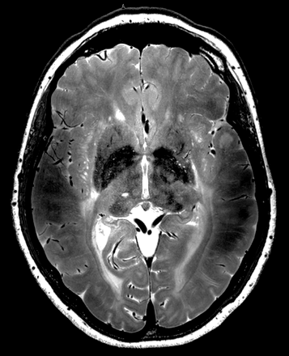
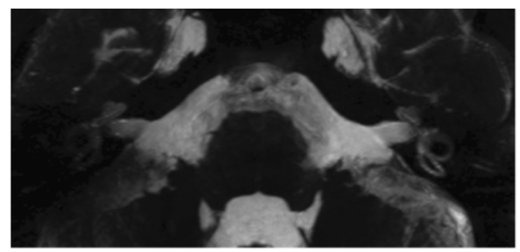

Slide 5
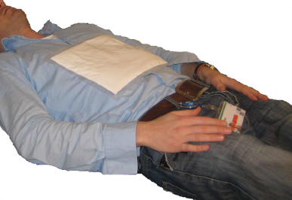
Introduction
The Effect of Dielectric Pads
De Heer et al., Magn Res Med (2012)

Slide 6
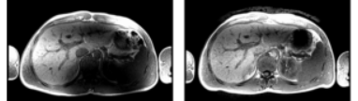
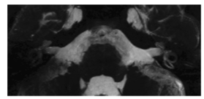
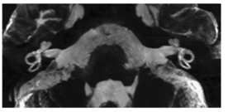
Introduction
The Effect of Dielectric Pads
Without pad
With pad
De Heer et al., Magn Res Med (2012)
Without pad
With pad
Brink et al., Invest Rad (2014)

Slide 7
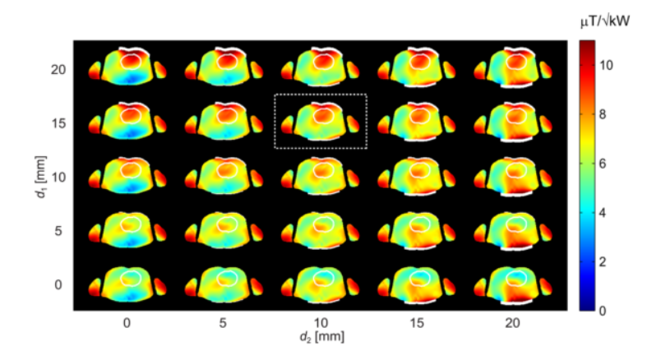
Introduction
Design Procedure: Numerical Modeling
Brink and Webb, Magn Res Med (2013)

Slide 8
Challenges
In Numerical Modeling
Strong (localized) inhomogeneities in medium parameters
Large computational domain due to the body model
Accurate for low resolution!
Fast!
Take into account the boundary conditions

Slide 9
Goal
Obtain a solution that is
1. accurate 2. obtained within short computation time
Approach:
Compare different discretization schemes for a simple test case
Compare two iterative solvers, GMRES and IDR(s), to solve the discretized system
Verify the results by performing human body simulations

Slide 10
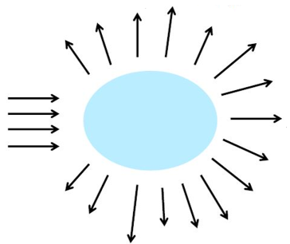
The Volume Integral Equation
${E \text{= }E}^{inc}+$ $E^{sc}$
$${E=E}^{inc}+\left(k_{b}^{2}+∇∇∙\right)S\left(χ_{e}E\right)$$
$$E^{sc}$$
$$S(J)=\int_{Ω}{g\left(x′−x\right)J\left(x\right)dx}$$
$$E^{inc}$$

Slide 11
Different Formulations
$$D=εE$$
EVIE: $E^{inc} = E − {(k}_{b}^{2}+∇∇∙)S\left(χ_{e}E\right)$
DVIE: ${ E}^{inc} = \frac{1}{ε}D −{ (k}_{b}^{2}+∇∇∙)S(\frac{χ_{e}}{ε}D)$

Slide 12
The Volume Integral Equation
$$E^{inc}=E−\left(k_{b}^{2}+∇∇∙\right)S\left(χ_{e}E\right)$$
$$2D$$
$$\left[\begin{matrix}E_{x}^{inc} \\ E_{y}^{inc}\end{matrix}\right]=\left[\begin{matrix}E_{x} \\ E_{y}\end{matrix}\right]−\left(k_{b}^{2}+∇∇∙\right)\left[\begin{matrix}S_{x}(χ_{e}E_{x}) \\ S_{y}(χ_{e}E_{y})\end{matrix}\right]$$
The $x$- and $y$-components of the electric field are coupled via the $∇∇∙$ operator.
The vector potential $S$ depends on the material parameters.

Slide 13
The Method of Moments
$$n$$
$$n$$
$$ℒu=f$$
$$Ax=b$$
$$6$$
$$6$$
$$3$$
$$3$$
$$5$$
$$4$$
$$5$$
$$1$$
$$2$$
$$4$$
$$1$$
$$2$$

Slide 14
The Method of Moments
Approximation of a Function
$$f\left(x\right)=\sum_{i=1}^{9}{f_{i}φ_{i}(x)}$$
$$f(x)$$
1. Specify $φ_{i}(x)$
2. Find $f_{i}$ for all $i$
3. Reconstruct $f(x)$
$$1$$
$$2$$
$$3$$
$$4$$
$$5$$
6
$$7$$
8
$$9$$
$$x_{i}$$

Slide 15
The Method of Moments
Expansions
$$\left[\begin{matrix}E_{x}^{inc} \\ E_{y}^{inc}\end{matrix}\right]=\left[\begin{matrix}E_{x} \\ E_{y}\end{matrix}\right]−\left(k_{b}^{2}+∇∇∙\right)\left[\begin{matrix}S_{x}(χ_{e}E_{x}) \\ S_{y}(χ_{e}E_{y})\end{matrix}\right]$$

Slide 16
The Method of Moments
Expansions
$$\left[\begin{matrix}E_{x}^{inc} \\ E_{y}^{inc}\end{matrix}\right]=\left[\begin{matrix}E_{x} \\ E_{y}\end{matrix}\right]−\left(k_{b}^{2}+∇∇∙\right)\left[\begin{matrix}S_{x}(χ_{e}E_{x}) \\ S_{y}(χ_{e}E_{y})\end{matrix}\right]$$
is solved via expanding
$$E_{x}\left(x\right)= \sum_{i=1}^{n}{e_{i}^{x}ψ_{i}^{x}\left(x\right)}$$
$$E_{y}(x)= \sum_{i=1}^{n}{e_{i}^{y}ψ_{i}^{y}(x)}$$

Slide 17
The Method of Moments
Expansions
$$\left[\begin{matrix}E_{x}^{inc} \\ E_{y}^{inc}\end{matrix}\right]=\left[\begin{matrix}E_{x} \\ E_{y}\end{matrix}\right]−\left(k_{b}^{2}+∇∇∙\right)\left[\begin{matrix}S_{x}(χ_{e}E_{x}) \\ S_{y}(χ_{e}E_{y})\end{matrix}\right]$$
is solved via expanding
$$E_{x}\left(x\right)= \sum_{i=1}^{n}{e_{i}^{x}ψ_{i}^{x}\left(x\right)}$$
$$E_{y}(x)= \sum_{i=1}^{n}{e_{i}^{y}ψ_{i}^{y}(x)}$$
$$S_{x}\left(x\right)= \sum_{i=1}^{n}{s_{i}^{x}ψ_{i}^{x}\left(x\right)}$$
$$S_{y}(x)= \sum_{i=1}^{n}{s_{i}^{y}ψ_{i}^{y}(x)}$$

Slide 18
The Method of Moments
Expansions
$$\left[\begin{matrix}E_{x}^{inc} \\ E_{y}^{inc}\end{matrix}\right]=\left[\begin{matrix}E_{x} \\ E_{y}\end{matrix}\right]−\left(k_{b}^{2}+∇∇∙\right)\left[\begin{matrix}S_{x}(χ_{e}E_{x}) \\ S_{y}(χ_{e}E_{y})\end{matrix}\right]$$
$$∇∇∙S= \left[\begin{matrix}\frac{∂}{∂x}\frac{∂}{∂x}S_{x}\text{+}\frac{∂}{∂x}\frac{∂}{∂y}S_{y} \\ \frac{∂}{∂y}\frac{∂}{∂x}S_{x}\text{+}\frac{∂}{∂y}\frac{∂}{∂y}S_{y}\end{matrix}\right]$$
$$A$$
$$\left[\begin{aligned}e^{x} \\ e^{y}\end{aligned}\right]=\left[\begin{aligned}b^{x} \\ b^{y}\end{aligned}\right]$$
How do we incorporate the operator $S$ in the matrix $A$?
How do we deal with the derivative terms?

Slide 19
The Method of Moments
Fast Fourier Transform
Remember,
$$S(χ_{e}E)(x^{′})=\int_{Ω}{g\left(x^{′}−x\right)χ_{e}(x)E\left(x\right)dx}$$
$$=g∗χ_{e}E$$
And
$$ℱ\left\{S\right\}=ℱ\left\{g∗χ_{e}E\right\}$$
$$=ℱ\left\{g\right\}ℱ\left\{χ_{e}E\right\}$$
$$⟹S=ℱ^{−1}\left\{ℱ\left\{g\right\}ℱ\left\{χ_{e}E\right\}\right\}.$$
So, use fast Fourier transform (FFT) algorithms to incorporate $S$ in the matrix $A$!

Slide 20
The Method of Moments
Expansions
$$\left[\begin{matrix}E_{x}^{inc} \\ E_{y}^{inc}\end{matrix}\right]=\left[\begin{matrix}E_{x} \\ E_{y}\end{matrix}\right]−\left(k_{b}^{2}+∇∇∙\right)\left[\begin{matrix}S_{x}(χ_{e}E_{x}) \\ S_{y}(χ_{e}E_{y})\end{matrix}\right]$$
$$∇∇∙S= \left[\begin{matrix}\frac{∂}{∂x}\frac{∂}{∂x}S_{x}\text{+}\frac{∂}{∂x}\frac{∂}{∂y}S_{y} \\ \frac{∂}{∂y}\frac{∂}{∂x}S_{x}\text{+}\frac{∂}{∂y}\frac{∂}{∂y}S_{y}\end{matrix}\right]$$
$$A$$
$$\left[\begin{aligned}e^{x} \\ e^{y}\end{aligned}\right]=\left[\begin{aligned}b^{x} \\ b^{y}\end{aligned}\right]$$
How do we incorporate the operator $S$ in the matrix $A$?
How do we deal with the derivative terms?

Slide 21
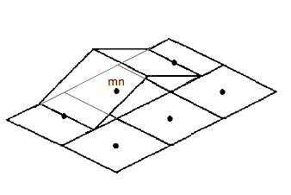
The Method of Moments
$$E_{x}\left(x\right)= \sum_{i=1}^{n}{e_{i}^{x}ψ_{i}^{x}\left(x\right)}$$
Basis Functions: Rooftop
$$x$$
$$y$$
$$x$$
$$y$$

Slide 22
The Method of Moments
Expansions
$$\left[\begin{matrix}E_{x}^{inc} \\ E_{y}^{inc}\end{matrix}\right]=\left[\begin{matrix}E_{x} \\ E_{y}\end{matrix}\right]−\left(k_{b}^{2}+∇∇∙\right)\left[\begin{matrix}S_{x}(χ_{e}E_{x}) \\ S_{y}(χ_{e}E_{y})\end{matrix}\right]$$
$$∇∇∙S= \left[\begin{matrix}\frac{∂}{∂x}\frac{∂}{∂x}S_{x}\text{+}\frac{∂}{∂x}\frac{∂}{∂y}S_{y} \\ \frac{∂}{∂y}\frac{∂}{∂x}S_{x}\text{+}\frac{∂}{∂y}\frac{∂}{∂y}S_{y}\end{matrix}\right]$$
$$A$$
$$\left[\begin{aligned}e^{x} \\ e^{y}\end{aligned}\right]=\left[\begin{aligned}b^{x} \\ b^{y}\end{aligned}\right]$$
How do we incorporate the operator $S$ in the matrix $A$?
How do we deal with the derivative terms?

Slide 23
Central Difference Schemes
On staggered and non-staggered grids
Non-staggered grid
Staggered grid

Slide 24
Central Difference Schemes
On staggered and non-staggered grids
Non-staggered grid
Staggered grid
$$m,n$$
$$m,n$$
$$m,n$$

Slide 25
Benchmark Problem
Scattering on a Two-Layer Conducting Cylinder
TE-polarization
$f=100 MHz$
Plane wave incident field
Muscle/fat tissue

Slide 26
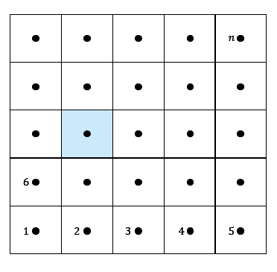
Recap
The Ingredients
Equations:
Method:
Benchmark Problem:
${ E \text{= }E}^{inc}+$ $E^{sc}$
Model

Slide 27
Results
Scattering on a Two-Layer Conducting Cylinder

Slide 28
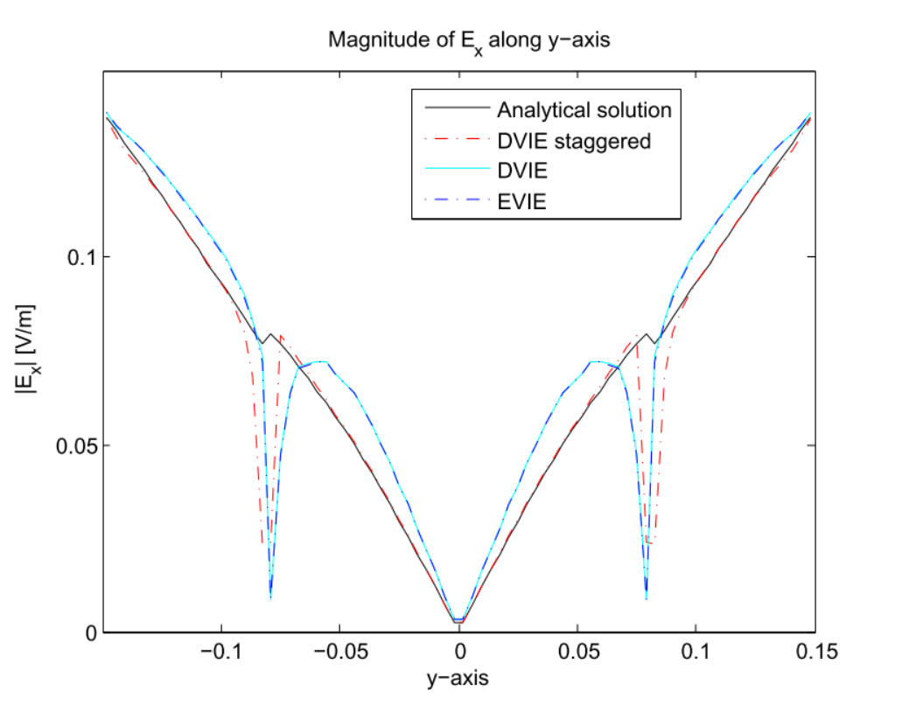
Results
Comparison of EVIE and DVIE

Slide 29
Results
Scattering on a Two-Layer Conducting Cylinder

Slide 30
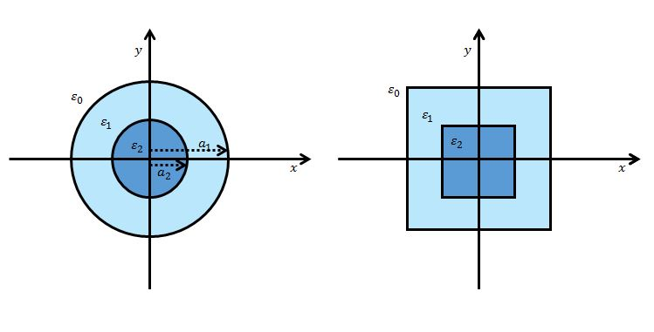
Scattering on a Circle vs Square

Slide 31
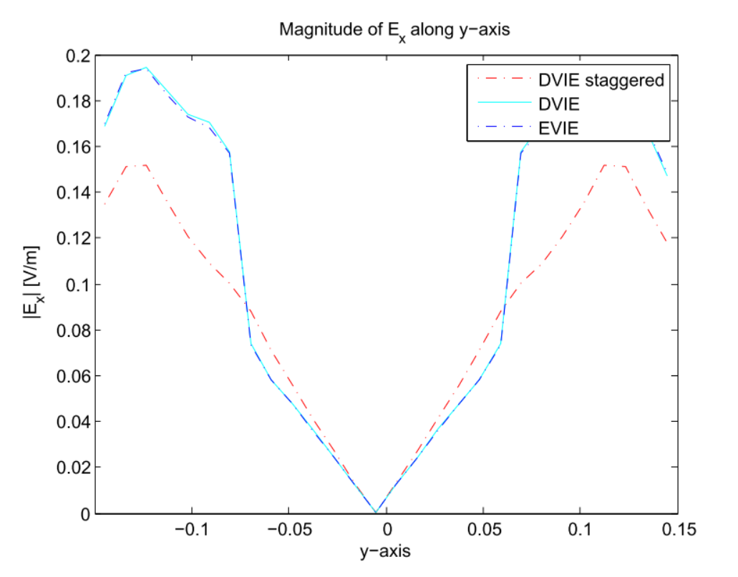
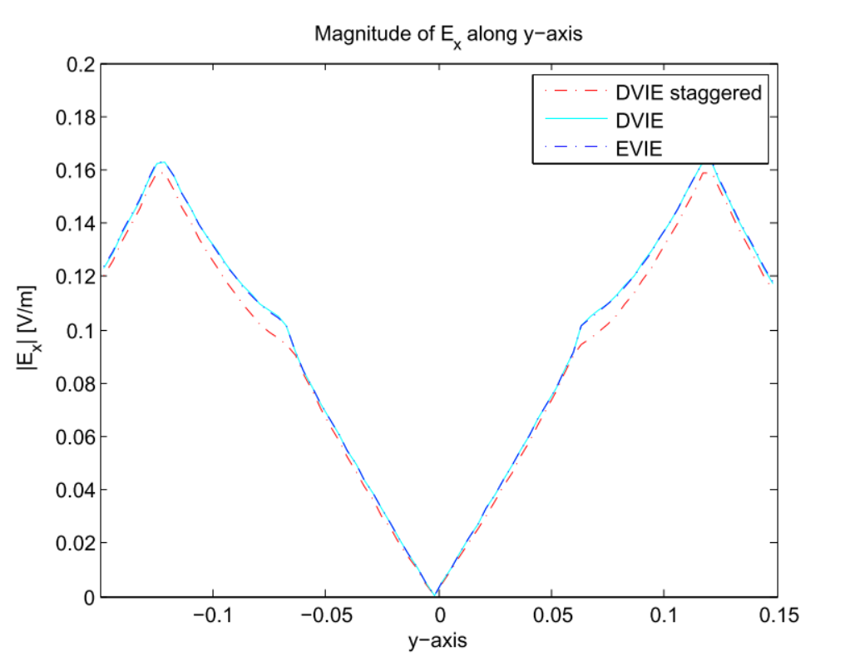
Results
Scattering on a Circle vs on a Square
Circle
Square

Slide 32
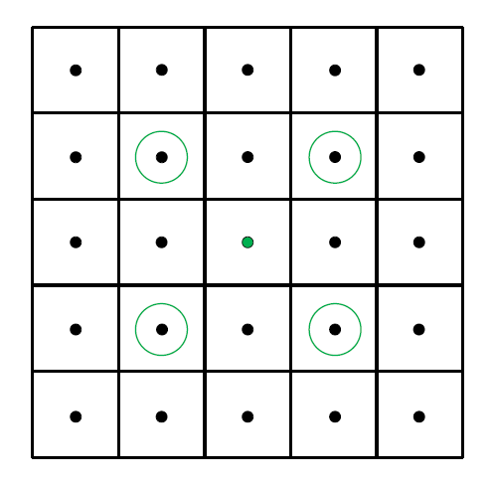
Central Difference Schemes
Non-Staggered
Staggered
2nd order scheme
4th order scheme

Slide 33
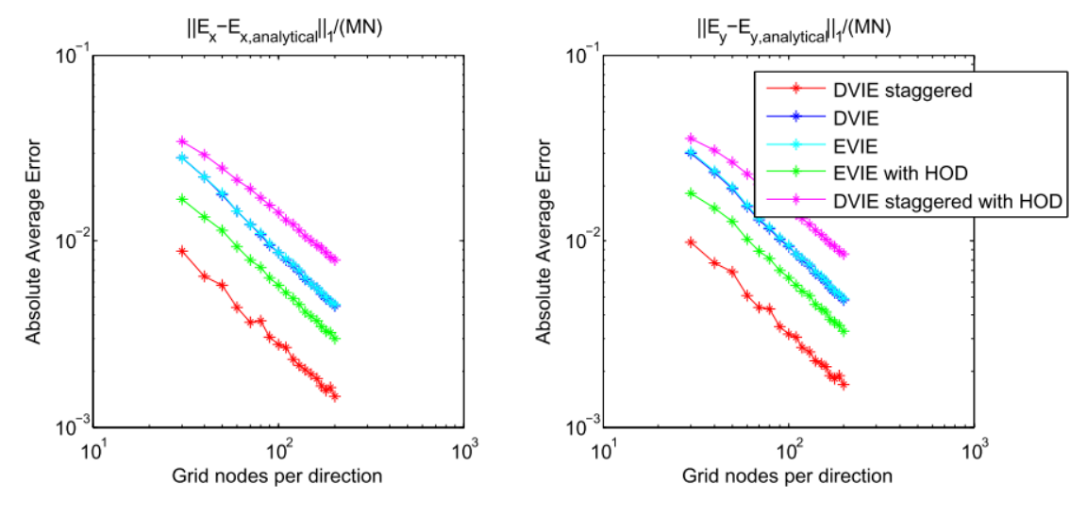
Results
Global Error Propagation

Slide 34
Error Reduction
Smoothing the Contrast
Original
With smoothing

Slide 35
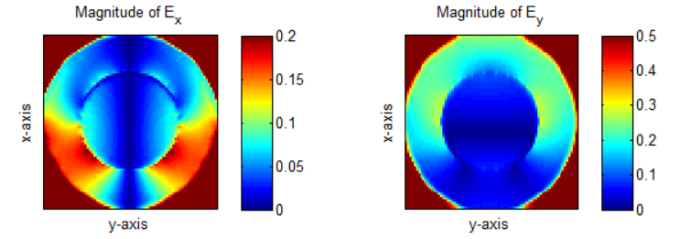
Results
The Effect of Smoothing the Contrast
Original
Smoothed

Slide 36
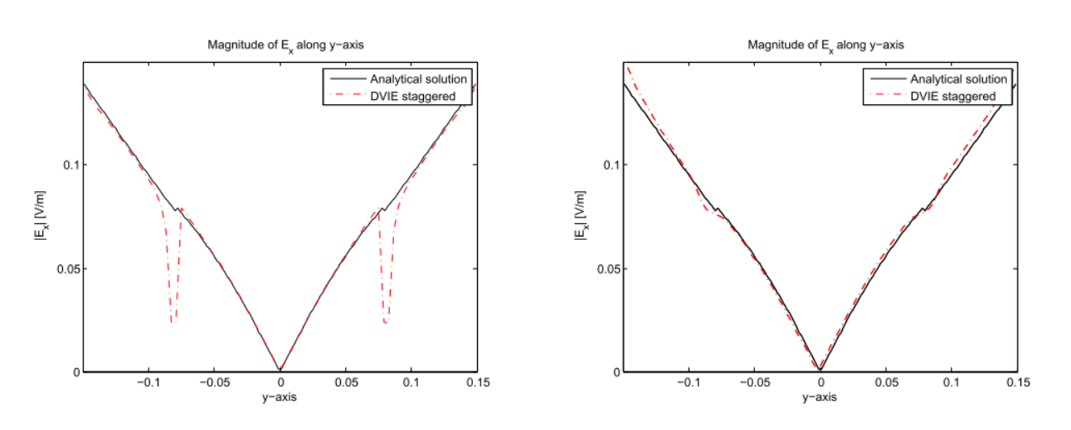
Results
The Effect of Smoothing along the Axes
Original
With smoothing

Slide 37
Overview
Finding a Solution
?
$$ℒu=f$$
$$Ax=b$$
$$x$$
Method of Moments
Iterative Solver
$$x^{i+1}=x^{i}+α^{i}$$

Slide 38
Properties of the Iterative Solver
Comparison of GMRES and IDR(s)
 | GMRES | IDR(s)
Iterations until convergence | $$n$$ | $$n+\frac{n}{s}$$
Work per iteration | $$𝒪\left(ni\right)$$ | $$𝒪(n)$$
$$n=$$
number of unknowns
$$i =$$
iteration number
Notes:
Applicable for non-symmetric systems
Krylov subspace method

Slide 39
Properties of the Iterative Solver
Comparison of GMRES and IDR(s)
 | GMRES | IDR(s)
Iterations until convergence | $$n$$ | $$n+\frac{n}{s}$$
Work per iteration | $$𝒪\left(ni\right)$$ | $$𝒪(n)$$
$$n=$$
number of unknowns
$$i =$$
iteration number
Notes:
Applicable for non-symmetric systems
Krylov subspace method

Slide 40
Properties of the Iterative Solver
Comparison of GMRES and IDR(s)
 | GMRES | IDR(s)
Iterations until convergence | $$n$$ | $$n+\frac{n}{s}$$
Work per iteration | $$𝒪\left(ni\right)$$ | $$𝒪(n)$$
$$n=$$
number of unknowns
$$i =$$
iteration number
Notes:
Applicable for non-symmetric systems
Krylov subspace method

Slide 41
Results
Comparison of GMRES and IDR(s)
GMRES
IDR(s)

Slide 42
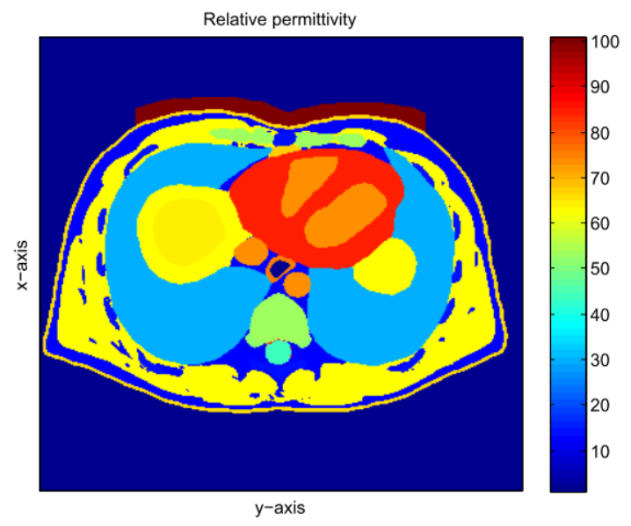
Human Body Simulations
Scattering on a Human Body with Dielectric Pad

Slide 43
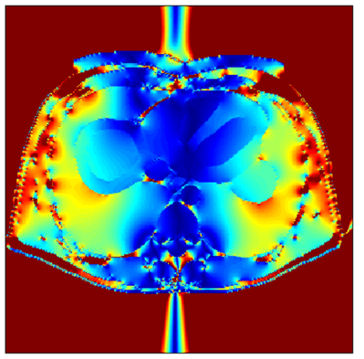
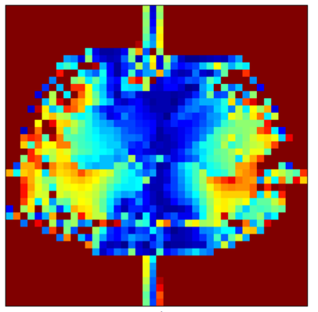
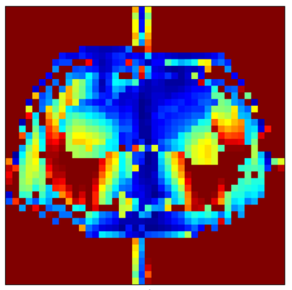
Human Body Simulations
Comparison of the staggered and non-staggered grid
High resolution
Low resolution
Low resolution
Staggered grid
Non-staggered grid

Slide 44
Conclusions
Factors that influence the accuracy are the geometry and the mixed derivative terms.
Smoothing improves the geometrical inaccuracies with the cost of computation time.
The mixed derivative term has a large effect on the accuracy and is best approximated on a staggered grid.
IDR(s) reduces the computation time considerably.
Human body simulations are in agreement with the cylider test case simulations: the DVIE method on a staggered grid results in the most accurate solution on low resolution.

Slide 45
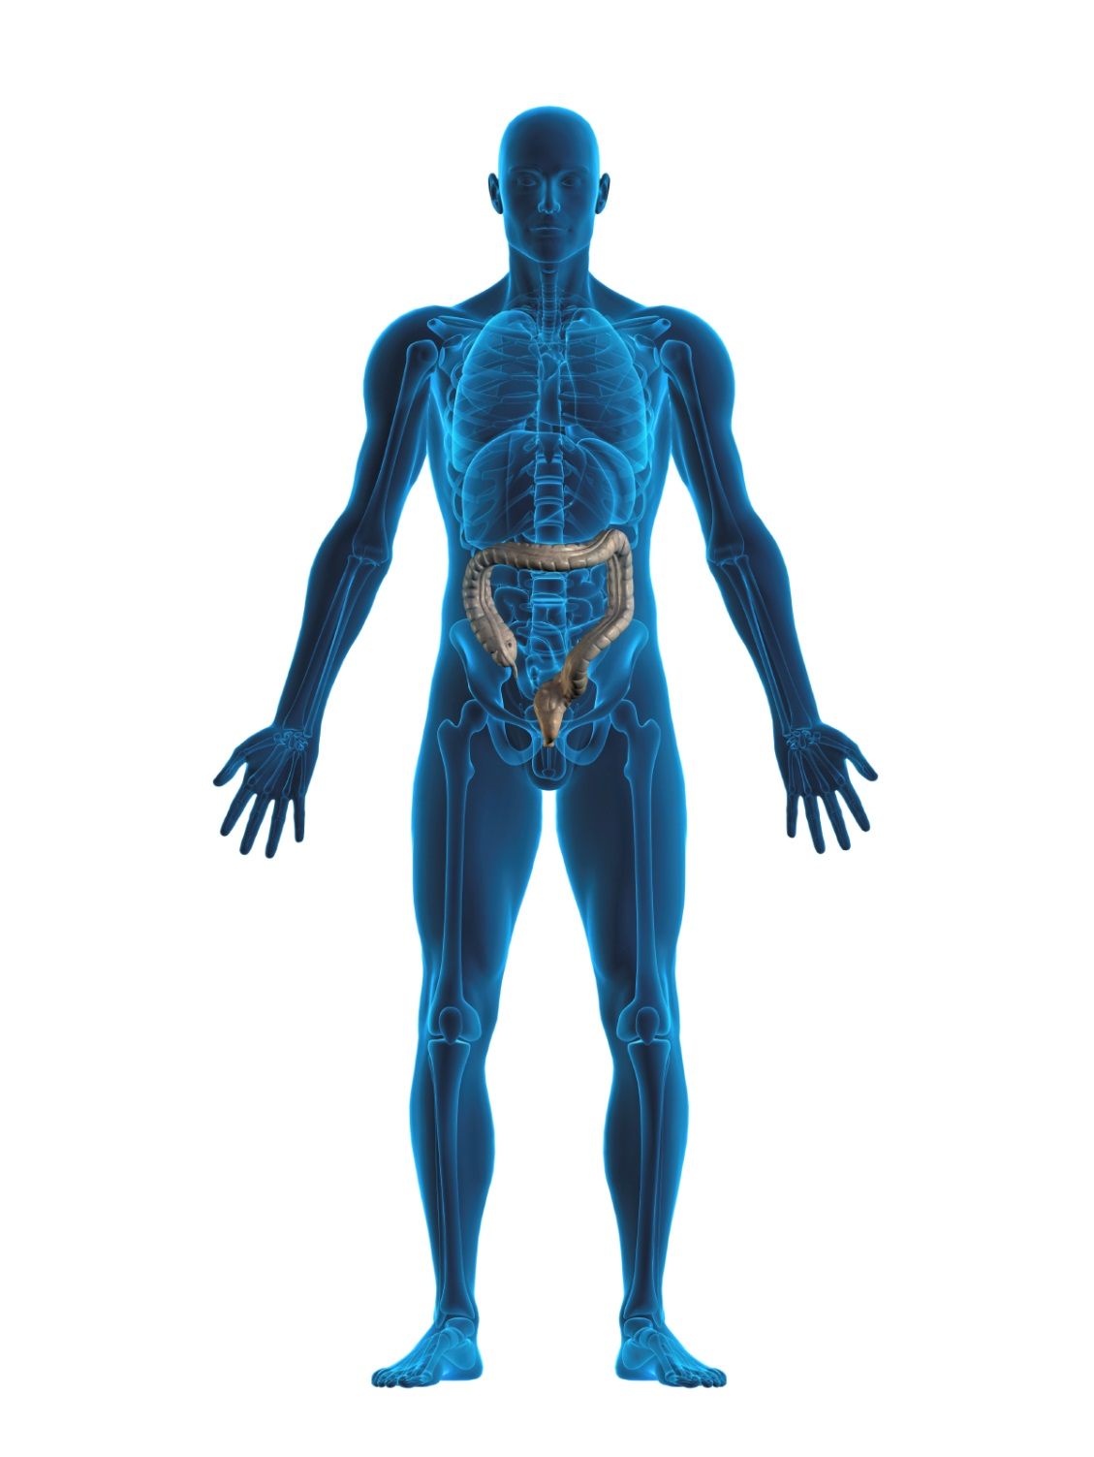
Abstract
Modeling electromagnetic fields in MRI involves two main challenges: the solution has to be accurate and it has to be obtained within short computation time. The method of moments is used to discretize different formulations of the volume integral equation corresponding to Maxwell's equations. The good performance of a staggered grid with respect to a non-staggered grid shows that the way of treating the mixed derivative terms is of great importance. The performance of a higher order derivative scheme on a non-staggered grid is close to the performance of a staggered grid. IDR(s) shows excellent performance in reducing the computation time that is obtained with GMRES.

Slide 46
Function Spaces
EVIE: $H\left(curl,ℝ^{3}\right)⟼ H\left(curl,ℝ^{3}\right)$
DVIE: $H\left(div,ℝ^{3}\right)⟼ H\left(curl,ℝ^{3}\right)$ JVIE: ${\left[L^{2}\left(ℝ^{3}\right)\right]}^{3}⟼{\left[L^{2}\left(ℝ^{3}\right)\right]}^{3}$
where
$$H\left(curl,ℝ^{3}\right)=\left\{f | f∈L^{2}\left(ℝ^{3}\right)∧ ∇×f∈L^{2}\left(ℝ^{3}\right)\right\}$$
$$H\left(div,ℝ^{3}\right)=\left\{f | f∈L^{2}\left(ℝ^{3}\right)∧ ∇∙f∈L^{2}\left(ℝ^{3}\right)\right\}$$

Slide 47
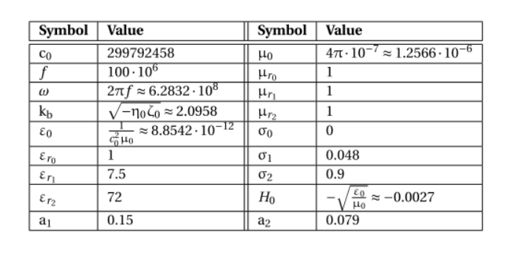
Simulation Parameters

Slide 48
Computation Times

Slide 49
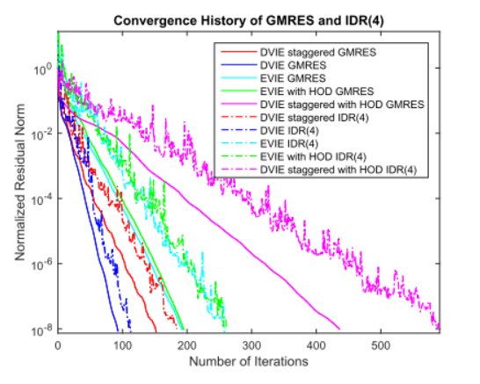
Convergence

Slide 50
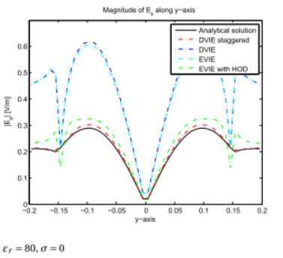
Contrast Dependence

Slide 51
Smoothing the Contrast
A Matlab Filter
$$ε_{m,n}=\sum_{R\left(m,n\right)}{\frac{1}{16}}ε_{p,q}$$

Slide 52
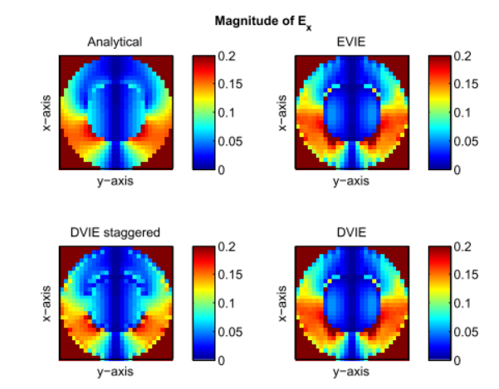
The Electric Fields

Slide 53
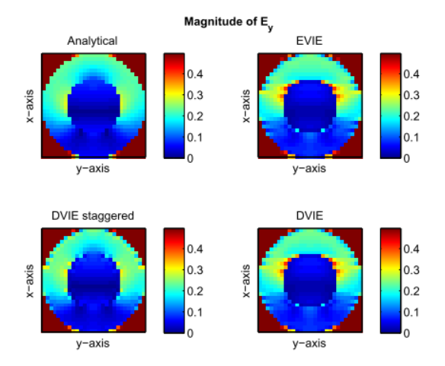
The Electric Fields

Slide 54
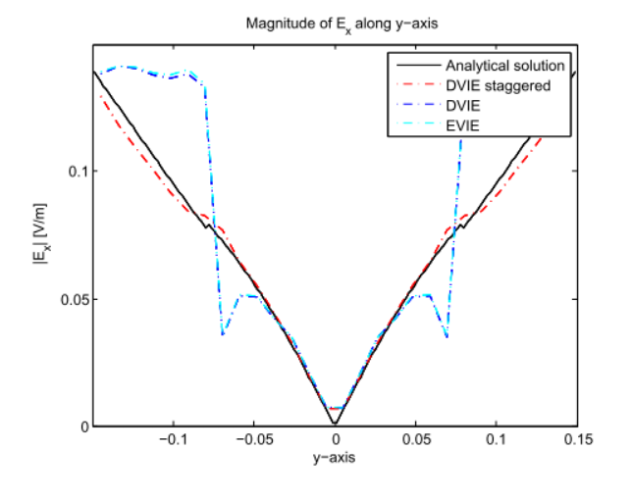
Scattering on a Two-Layer Cylinder
Low Resolution Results

Slide 55
The Electric Fields
Scattering on a Square-Shaped Object

